Slide 1
앵귤러 첫걸음
Ch-03

Slide 2
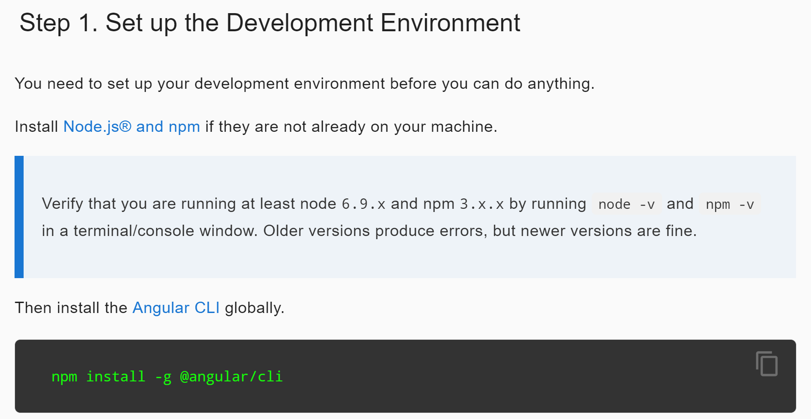
CLI Install

Slide 3
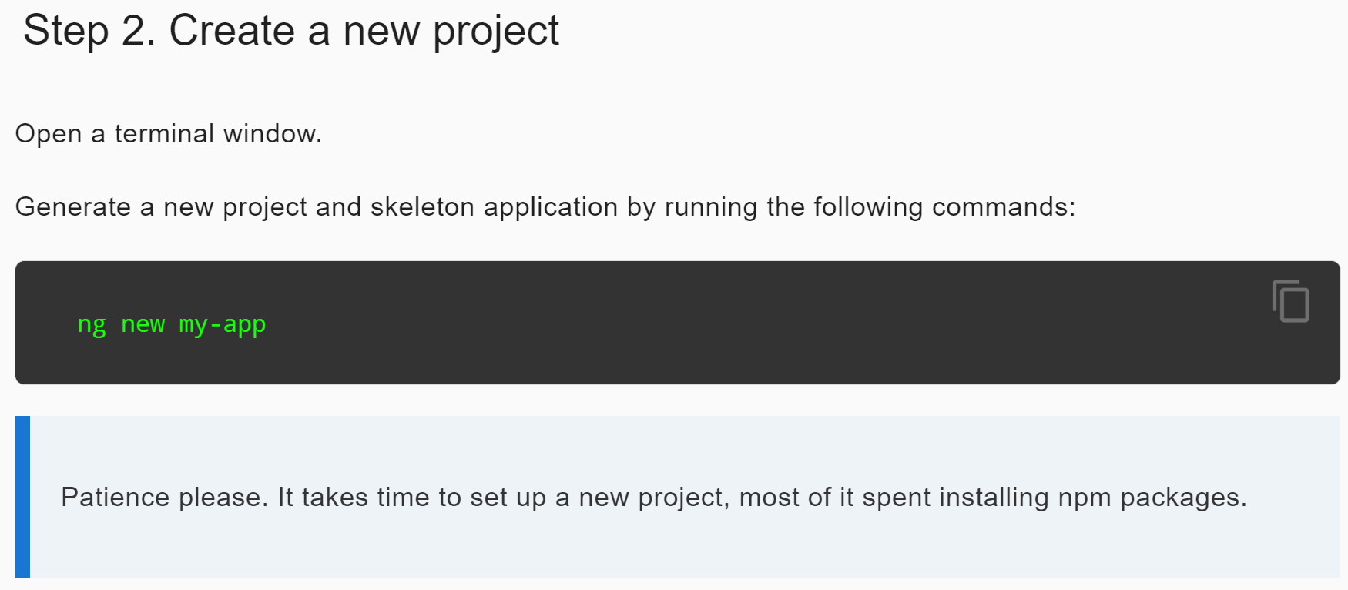
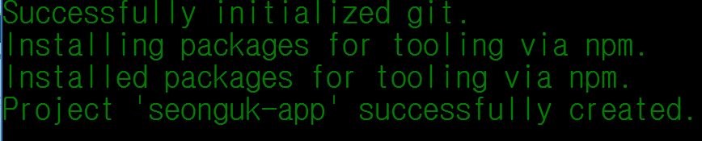
Create New Skeleton project of Angular

Slide 4
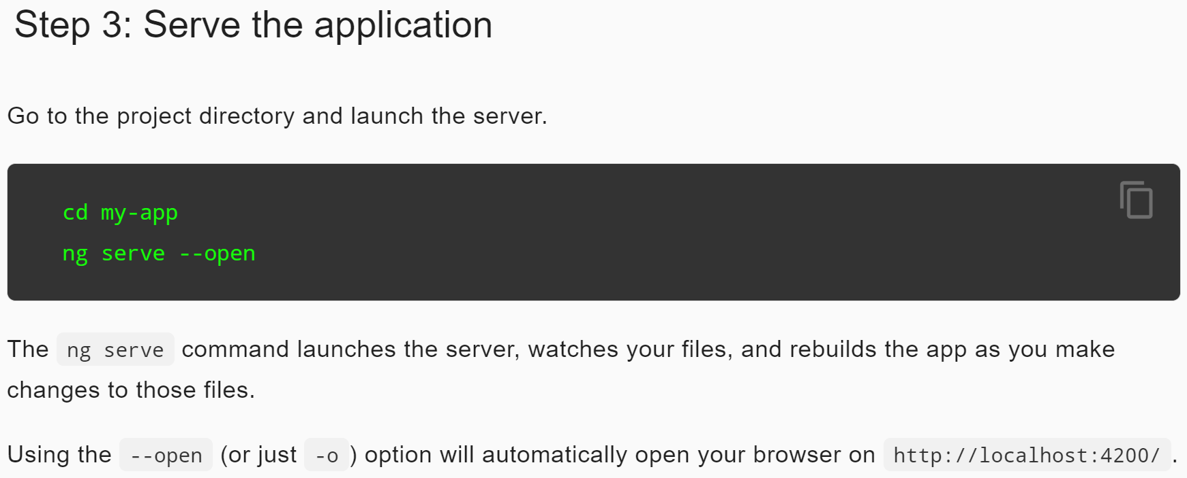
Serve the app

Slide 5
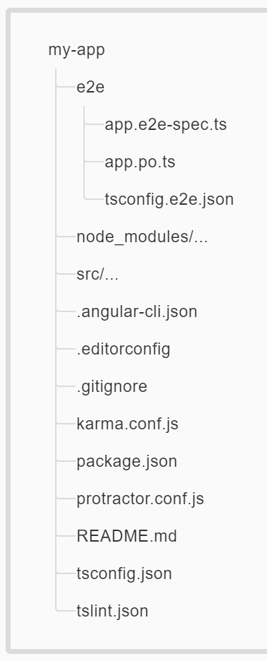
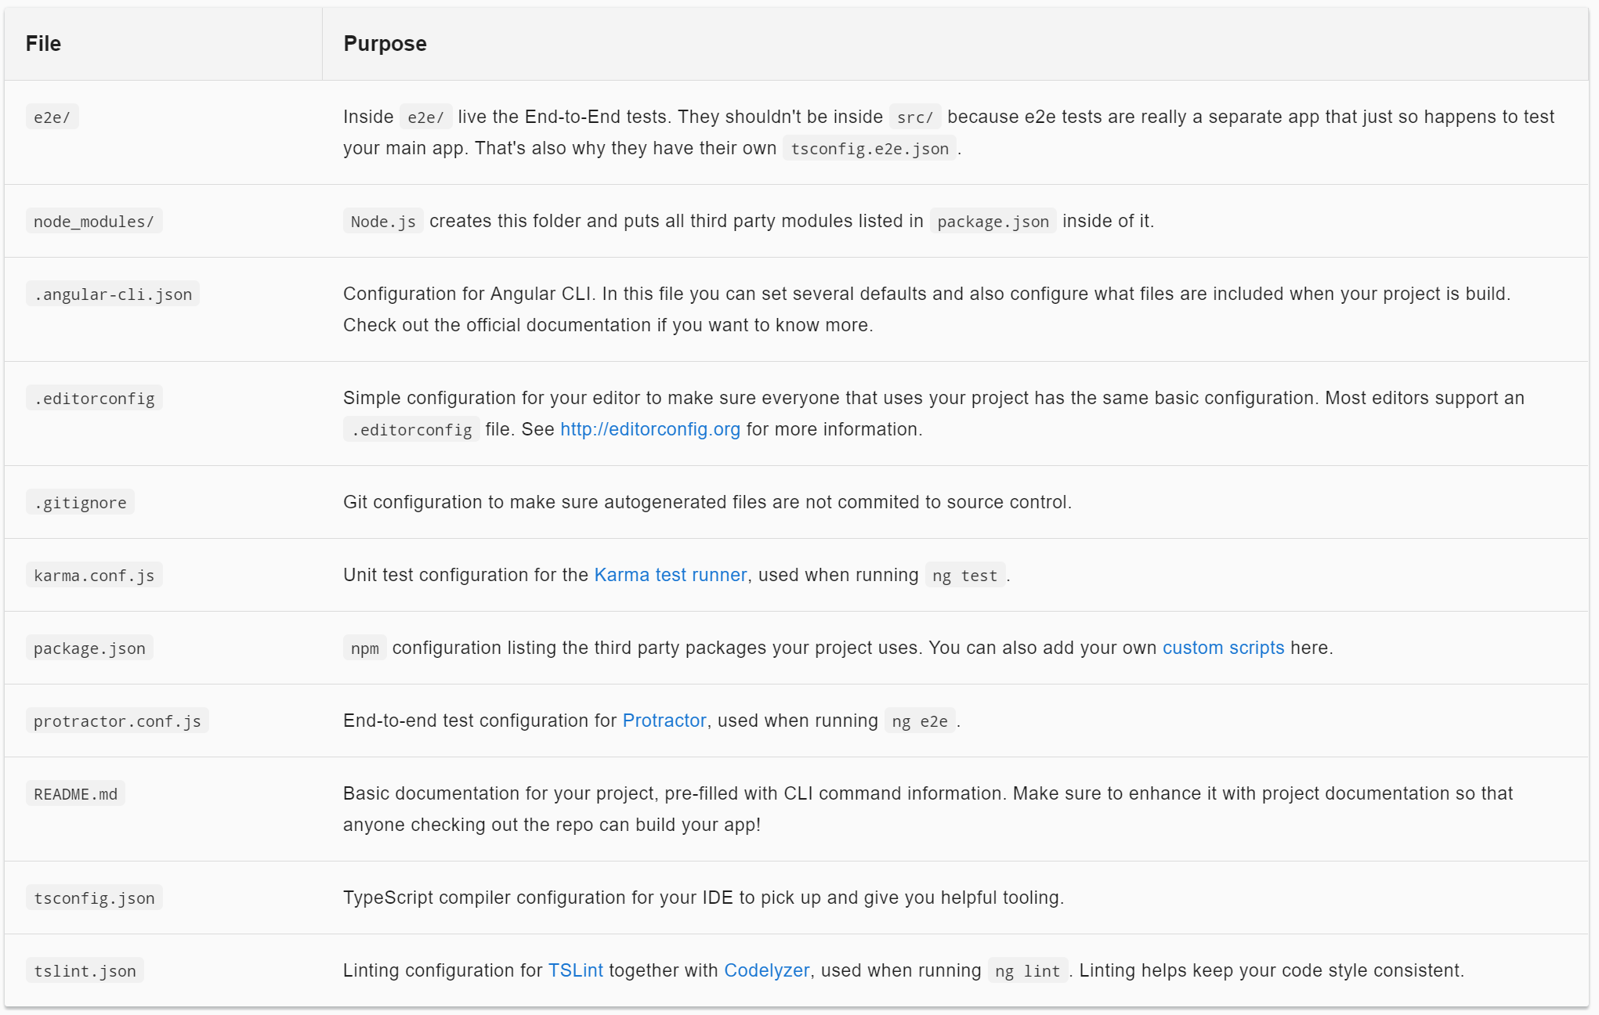
Root Folder

Slide 6
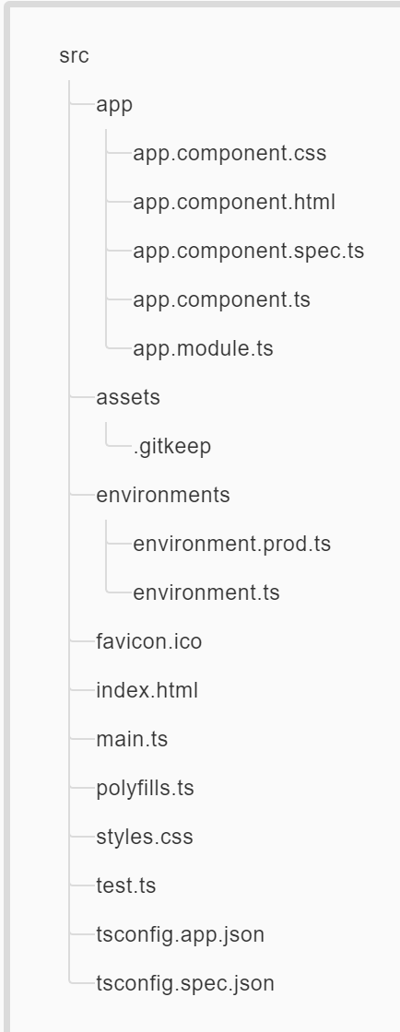
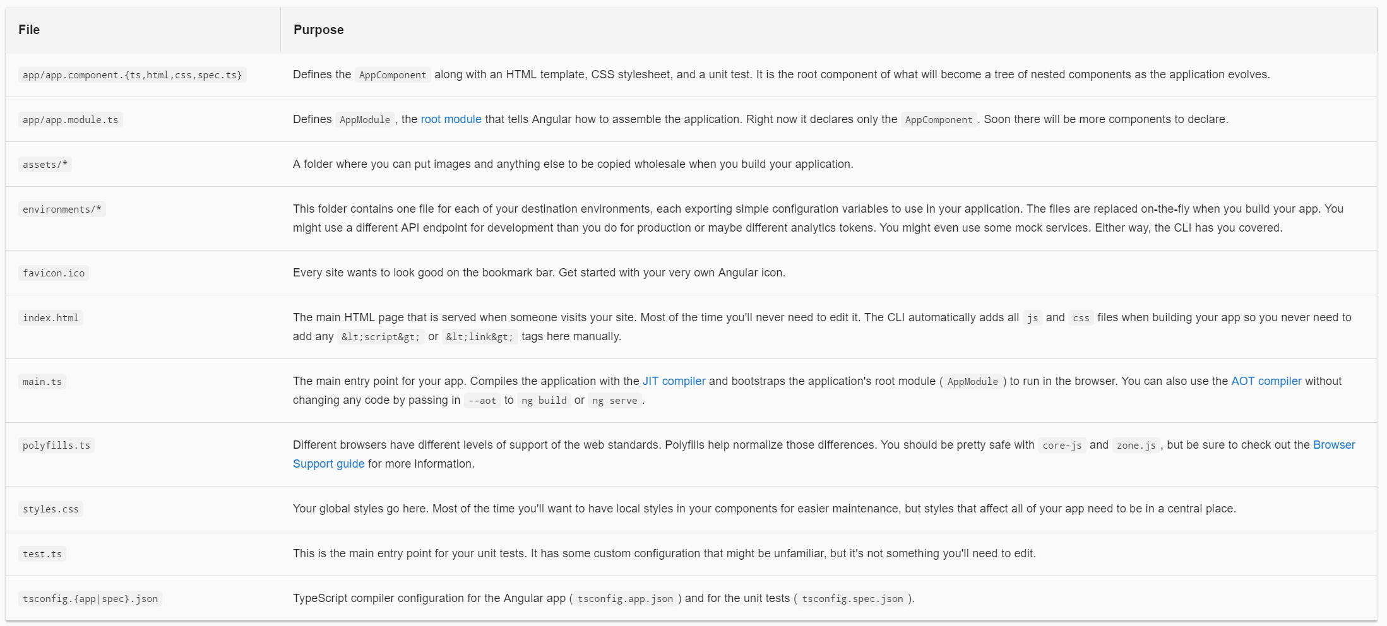
src Folder
Your app lives in the src folder.
All angular components, templates, styles, images, and anything else
Your app needs go here.
Any files outside of this folder are meant to support building your app.

Slide 7
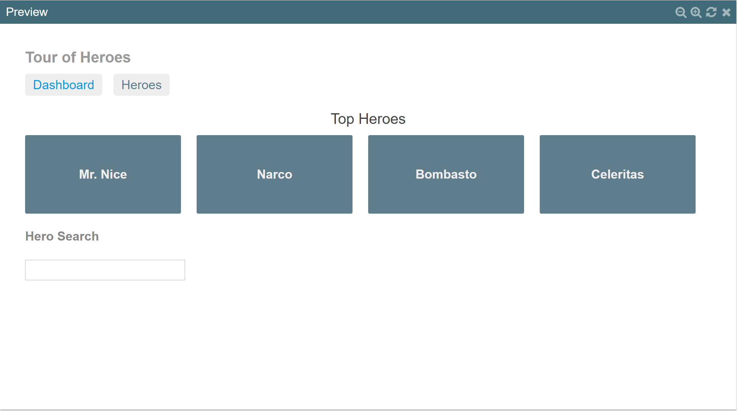
Why component?
Components are divided by functional unit.

Slide 8
component
Component is composed of View and own manipulator
View
app.component.html
app.component.css
App.component.ts
App.component.html
App.component.css
Manipulator
app.component.ts

Slide 9
app.component.ts
import { Component } from '@angular/core';
@Component({
selector: 'app-root',
templateUrl: './app.component.html',
styleUrls: ['./app.component.css']
}) export class AppComponent {
userName = "";
setName(name) {
this.userName = name;
}
}
Decorator
Indicate this class is component
and have organization of component
selector
Define the tag name which pointing
component in template

Slide 10
app.component.html
<h4>
<span id="display-name" {{userName}}></span>님 환영합니다.
</h4>
<div class="contents">
<label for="user-name">사용자 이름: </label>
<input type="text" name="user-name" id="user-name" #nameInput>
<button type="button" (click)="setName(nameInput.value)">입력</button>
</div>

Slide 11
Data Binding
One-way binding
Binding to events
Binding to properties and attributes
Binding in templates
Two-way Binding

Slide 12
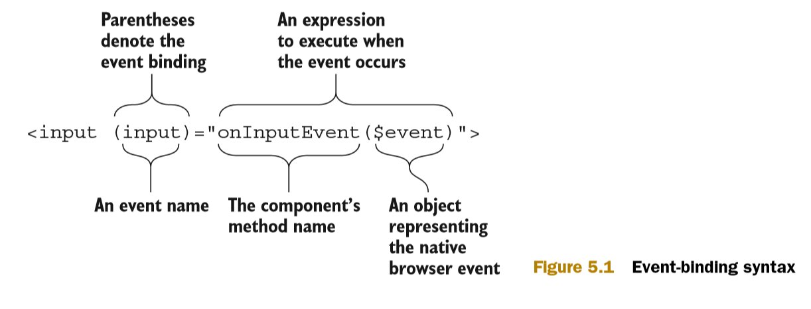
One-way binding : Binding to events
To assign an event-handler function to an event
you need to put the event name in parentheses in the component’s template.
The following code snippet shows how to bind the function onClickEvent() to the click event, and the function onInputEvent() to the input event:

Slide 13
One-way binding : Binding to properties and attributes
To assign an event-handler function to an event
you need to put the event name in parentheses in the component’s template.
The following code snippet shows how to bind the function onClickEvent() to the click event, and the function onInputEvent() to the input event:

Slide 14
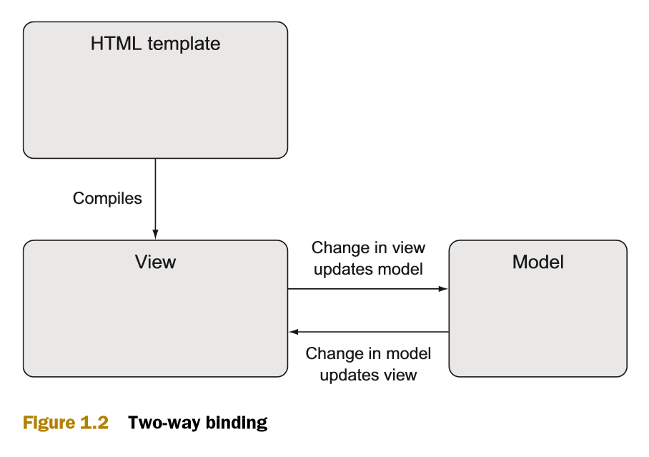
Two-way Binding
[(gModel)] = “userName”
Basic example :
http://plnkr.co/edit/nkww1Ov2AWZRMHFyjhjl?p=preview

Slide 15


Service, Pipe
Component is template
Service is contents
Pipe is format

